Slide 1
Form Redisplaying

Slide 2
Eh?
Now we know how to check whether or not user inputs conform to our rules…
… we need to handle gracefully when they fail!
User inputs come from forms, and we need to work out how to re-display forms on input validation failure.

Slide 3
What are we shooting for?
Bullet-proof validation.
On validation failure, form should be re-displayed to the user.
Don’t make the user fill in fields again that they’ve already done correctly.
We want to have to write the form html only once.
If validation fails, the user needs some feedback.

Slide 4
The One True Way?
There are multiple ways to achieve this..
I am going to demonstrate ONE way, but you should be aware that it’s not the ONLY way.

Slide 5
Single Page
Make the form submit to the same page.
Why? It keeps everything in one place, and means you only write the form once.
<form action="<?php echo $_SERVER['PHP_SELF']; ?>"
method="post"
…

Slide 6
Page Logic
if (form has been submitted) {
// validate form
}
if (valid submission) {
// action data
} else {
// (re)display form
}

Slide 7
Validation..
if (form has been submitted) {
// validate form
}
…can be implemented as…
if (isset($_POST[‘submit’])) {
// validate form
}

Slide 8
Maintain separation
Maintaining separation between validated and un-validated data helps prevent you make mistakes.
$_POST $clean
UNSAFE SAFE

Slide 9
Accumulate errors..
$errors = 0;
$errmsg = ‘’;
$clean = array();
if (isset($_POST[‘submit’])) {
if ($_POST[‘value’] is VALID) {
$clean[‘value’] = $_POST[‘value’];
} else {
$errors++;
$errmsg .= ‘data not valid because…’;
}
// continue testing other fields..
}

Slide 10
Now to action or display..
if (form has been submitted) {
// validate form
}
if (valid submission) {
// action data
} else {
// (re)display form
}

Slide 11
Now to action or display..
if (isset($_POST[‘submit’])) &&
$errors===0) {
// action data
} else {
// (re)display form
}

Slide 12
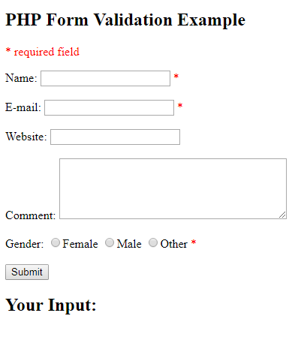
Example

Slide 13
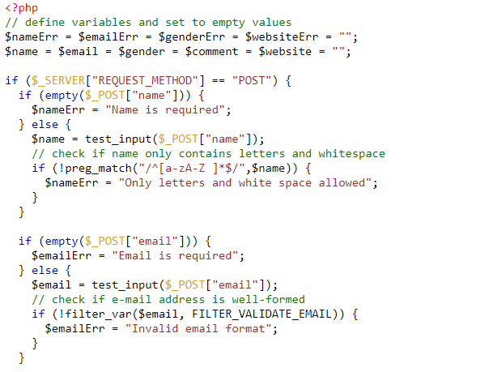
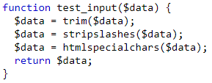
Example Code

Slide 14
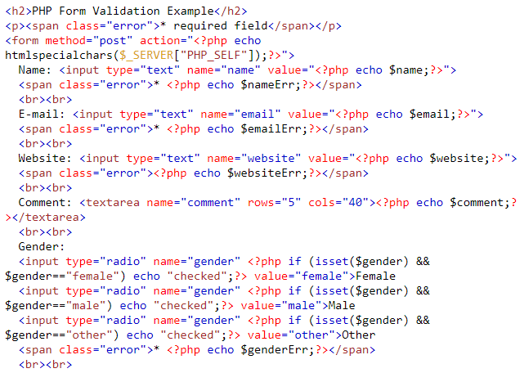
Example Code

Slide 15
PHP $_SERVER variables
$_SERVER['PHP_SELF']: Returns the filename of the currently executing script
$_SERVER['SERVER_ADDR']: Returns the IP address of the host server
$_SERVER['SERVER_NAME']: Returns the name of the host server (such as www.w3schools.com)
$_SERVER['SERVER_SOFTWARE']: Returns the server identification string (such as Apache/2.2.24)
$_SERVER['SERVER_PROTOCOL']: Returns the name and revision of the information protocol (such as HTTP/1.1)
$_SERVER['REQUEST_METHOD']: Returns the request method used to access the page (such as POST)
$_SERVER['REQUEST_TIME']: Returns the timestamp of the start of the request (such as 1377687496)
$_SERVER['QUERY_STRING']: Returns the query string if the page is accessed via a query string

Slide 16
PHP $_SERVER variables
$_SERVER['REMOTE_ADDR']: Returns the IP address from where the user is viewing the current page
$_SERVER['REMOTE_HOST']: Returns the Host name from where the user is viewing the current page
$_SERVER['REMOTE_PORT']: Returns the port being used on the user's machine to communicate with the web server
$_SERVER['SCRIPT_FILENAME']: Returns the absolute pathname of the currently executing script

